Slide 1
Chapter 6: CPU Scheduling
Modified by Maria

Slide 2
Chapter 6: CPU Scheduling
Basic Concepts
Scheduling Criteria
Scheduling Algorithms
Thread Scheduling
Multiple-Processor Scheduling
Real-Time CPU Scheduling
Operating Systems Examples
Algorithm Evaluation

Slide 3
Objectives
To introduce CPU scheduling, which is the basis for multiprogrammed operating systems
To describe various CPU-scheduling algorithms
To discuss evaluation criteria for selecting a CPU-scheduling algorithm for a particular system
To examine the scheduling algorithms of several operating systems

Slide 4
Basic Concepts
Maximum CPU utilization obtained with multiprogramming
CPU–I/O Burst Cycle – Process execution consists of a cycle of CPU execution and I/O wait
CPU burst followed by I/O burst
CPU burst distribution is of main concern
Notes:
-load means load from memory into register
http://www.cs.uaf.edu/2004/fall/cs301/notes/Chapter8/node4.html
-When speaking about scheduling, processes are traditionally classified as "I/O-bound" or "CPU-bound.“ The former make heavy use of I/O devices and spend much time waiting for I/O operations to complete; the latter are number-crunching applications that require a lot of CPU time.
An alternative classification distinguishes three classes of processes:
Interactive processes
These interact constantly with their users, and therefore spend a lot of time waiting for keypresses and mouse operations. When input is received, the process must be woken up
quickly, or the user will find the system to be unresponsive. Typically, the average delay must fall between 50 and 150 ms.
The variance of such delay must also be bounded, or the user will find the system to be erratic.
Typical interactive programs are command shells, text editors, and graphical applications.
Batch processes
These do not need user interaction, and hence they often run in the background. Since such processes
do not need to be very responsive, they are often penalised by the scheduler. Typical batch programs
are programming language compilers, database search engines, and scientific computations.
Real-time processes
These have very strong scheduling requirements. Such processes should never be blocked by
lower-priority processes, they should have a short response time and, most important, such
response time should have a minimum variance. Typical real-time programs are video and
sound applications, robot controllers, and programs that collect data from physical sensors.
The two classifications we just offered are somewhat independent. For instance, a batch process
can be either I/O-bound (e.g., a database server) or CPU-bound (e.g., an image-rendering program).

Slide 5
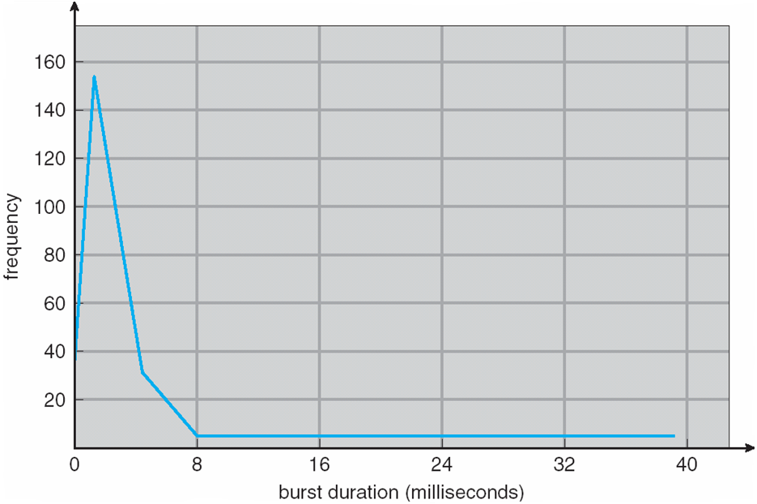
Histogram of CPU-burst Times
Notes:
-Typical curve, exponential.
Other examples: bank queues, raindrops, radioactivity, telephone calls to an exchange, requests to webserver for a page.
In probability theory and statistics, the exponential distributions are a class of continuous probability distributions. They describe the times between events in a Poisson process, i.e. a process in which events occur continuously and independently at a constant average rate.
http://en.wikipedia.org/wiki/Exponential_distribution
http://en.wikipedia.org/wiki/Exponential_distribution#Occurrence_and_applications
http://en.wikipedia.org/wiki/Poisson_process#Applications
-Has many short CPU bursts and few long ones. This is characteristic of I/O-bound processes.
-CPU-bound processes have a few long CPU bursts as well.
-Note that the length of the CPU-burst is the criterion for both process types. I/O-bound ones only do little computation between I/O bursts.
-Important while selecting a CPU-scheduling algorithm.
http://www.forvo.com/word/poisson/
-As CPUs becoming faster as compared to disks, processes becoming more I/O-bound.
-FIG 2-6 P.92 TANENBAUM. More I/O-bound processes needed to keep CPU fully utilised.

Slide 6
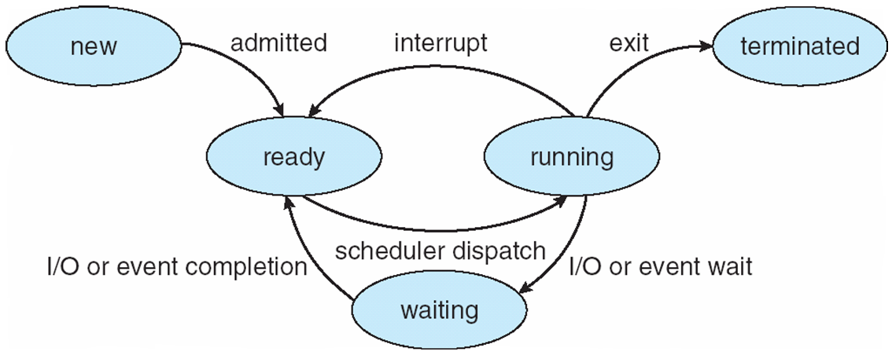
Diagram of Process State (State Diagram)

Slide 7
CPU Scheduler
Short-term scheduler selects from among the processes in ready queue, and allocates the CPU to one of them
Queue may be ordered in various ways
CPU scheduling decisions may take place when a process:
1. Switches from running to waiting state
2. Switches from running to ready state
3. Switches from waiting to ready
Terminates
Scheduling of 1 and 3 is preemptive
Consider access to shared data
Consider preemption while in kernel mode
Consider interrupts occurring during crucial OS activities
Notes:
• Scheduling is preemptive if the CPU can be taken away
-Preemptive scheduling can introduce race conditions and can also leave kernel in an inconsistent state.
-One process writing shared data can be preempted midway. Another process can later try to read the shared inconsistent data.
-Similarly, kernel might be modifying kernel data (e.g. I/O queues) during a system call when it’s preempted. UNIX either waits for a system call to complete, or an I/O block to occur before context switching.
-Interrupts disabled when entering critical pieces of shared code and reenabled on exit (such pieces of code are short and few).

Slide 8
Dispatcher
Dispatcher module gives control of the CPU to the process selected by the short-term scheduler; this involves:
switching context
switching to user mode
jumping to the proper location in the user program to restart that program
Dispatch latency – time it takes for the dispatcher to stop one process and start another running
Notes:
The dispatcher in Operating System is a module that selects the process from the ready queue for allotting it the CPU (Processor).

Slide 9
Scheduling Criteria
CPU utilization – keep the CPU as busy as possible
Throughput – # of processes that complete their execution per time unit
Turnaround time – amount of time to execute a particular process
Waiting time – amount of time a process has been waiting in the ready queue
Response time – amount of time it takes from when a request was submitted until the first response is produced, not output (for time-sharing environment)
Notes:
-CPU utilisation should range from 40% to 90% in lightly and heavily-loaded systems respectively.
-Turnaround time = time to get into memory + time in ready queue + time executing on CPU and doing I/O.
-The scheduling algo doesn’t affect the time spent executing/doing I/O. It only affects time spent waiting
in the ready queue.
-Response time important in interactive systems. Limited by the speed of the output device.

Slide 10
Scheduling Algorithm Optimization Criteria
Max CPU utilization
Max throughput
Min turnaround time
Min waiting time
Min response time
Notes:
-In most cases, we try to optimise the average times. But sometimes also optimise the minimum or maximum values, e.g., the max response time of an interactive system.
-Also, think about variance in response time in timesharing systems. Not much work done on this but is more important than response time itself in interactive systems. A system with predictable response time may be preferable to a faster on average but more variant response time system.

Slide 11
First- Come, First-Served (FCFS) Scheduling
Process Burst Time
P₁ 24
P₂ 3
P₃ 3
Suppose that the processes arrive in the order: P₁ , P₂ , P₃ The Gantt Chart for the schedule is:
Waiting time for P₁ = 0; P₂ = 24; P₃ = 27
Average waiting time: (0 + 24 + 27)/3 = 17
Turnaround time: P1= 24, P2=27, and P3=30
Notes:
-Burst Time is actually time that is required to complete execution of particular task or process.
Also called FIFO (first in, first out)
-Criterion is average waiting time; also, we consider only one CPU burst rather than many.
-Processes arrive at time 0 in the above order (P1, P2, P3).
-Gantt chart: http://en.wikipedia.org/wiki/Gantt_chart
-With this scheme, the process that requests the CPU first is allocated the CPU first. The implementation of the FCFS policy is easily managed with a FIFO queue. When a process enters the ready queue, its PCB is linked onto the tail of the queue. When the CPU is free, it is allocated to the process at the head of the queue.

Slide 12
FCFS Scheduling (Cont.)
Suppose that the processes arrive in the order:
P₂ , P₃ , P₁
The Gantt chart for the schedule is:
Waiting time for P₁ = 6; P₂ = 0; P₃ = 3
Average waiting time: (6 + 0 + 3)/3 = 3
Much better than previous case; but variable av. waiting time
Convoy effect - short process behind long process
Consider one CPU-bound and many I/O-bound processes
Notes:
-Read book about convoy effect, p.267.
-There is a convoy effect as all the other processes wait for the one big process to get off the CPU. This effect results in lower CPU and device utilization than might be possible if the shorter processes were allowed to go first.

Slide 13
Shortest-Job-First (SJF) Scheduling
Associate with each process the length of its next CPU burst
Use these lengths to schedule the process with the shortest time
SJF is optimal – gives minimum average waiting time for a given set of processes
The difficulty is knowing the length of the next CPU request
Could ask the user
usually uses for long term scheduling
Notes:
-Usually used for long-term scheduling, not short-term. User who submits job also submits a time limit for the process to finish. Shorter would mean quicker turn on the CPU. This time limit used as burst time.

Slide 14
Example of SJF
ProcessArriva l Time Burst Time
P₁ 0.0 6
P₂ 2.0 8
P₃ 4.0 7
P₄ 5.0 3
SJF scheduling chart
Average waiting time = (3 + 16 + 9 + 0) / 4 = 7
Notes:
-Calculate for FCFS scheduling.

Slide 15
Determining Length of Next CPU Burst
Can only estimate the length – should be similar to the previous one
Then pick process with shortest predicted next CPU burst
Preemptive version called shortest-remaining-time-first
Notes:
//en.wikipedia.org/wiki/Moving_average#Exponential_moving_average

Slide 16
Shortest-remaining-time-first
Preemptive version called shortest-remaining-time-first
Now we add the concepts of varying arrival times and preemption to the analysis
ProcessA arri Arrival TimeT Burst Time
P₁ 0 8
P₂ 1 4
P₃ 2 9
P₄ 3 5
Preemptive SJF Gantt Chart
Average waiting time = [(10-1)+(1-1)+(17-2)+(5-3)]/4 = 26/4 = 6.5 msec
Turnaround time: P1= 17, P2=4, P3=24 and P4=7
Notes:
-Nonpreemptive SJF scheduling would result in an average waiting time of 7.75 milliseconds.

Slide 17
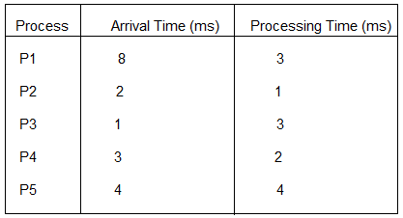
Another example
Do by yourself for practicing the concepts
calculate Average Waiting Time and average Turn-around time using FCFS and SJF and SRTF.

Slide 18
Priority Scheduling
A priority number (integer) is associated with each process
The CPU is allocated to the process with the highest priority (smallest integer ≡ highest priority)
Preemptive
Nonpreemptive
SJF is priority scheduling where priority is the inverse of predicted next CPU burst time
Problem ≡ Starvation – low priority processes may never execute
Solution ≡ Ageing – as time progresses increase the priority of the process e.g. increase priority by one every 10 minutes.
Notes:
-In this text, assume low number means high priority.
-Priority decided internally or externally.
Internal factors: time limits, memory requirements, number of open files, (av. I/O burst)/(av. CPU burst).
External factors: importance, funds paid for computer use, dept. whose process it is, other political factors.
-A low priority process was waiting for execution from 1967 to 1973 at a mainframe at MIT.
-Ageing: e.g. increase priority by one every 10 minutes.

Slide 19

Example of Priority Scheduling
ProcessA arri Burst TimeT Priority
P₁ 10 3
P₂ 1 1
P₃ 2 4
P₄ 1 5
P₅ 5 2
Priority scheduling Gantt Chart
Average waiting time = 8.2 msec
Turnaround time:
Notes:
-Processes arrived at time 0.

Slide 20
Round Robin (RR)
Each process gets a small unit of CPU time (time quantum q), usually 10-100 milliseconds. After this time has elapsed, the process is preempted and added to the end of the ready queue.
If there are n processes in the ready queue and the time quantum is q
Timer interrupts every quantum to schedule next process
Performance
q large ⇒ FIFO
q small ⇒ q must be large with respect to context switch, otherwise overhead is too high
Notes:
-Ready queue is a circular queue filled in a FCFS way.

Slide 21
Example of RR with Time Quantum = 4
Process Burst Time
P₁ 24
P₂ 3
P₃ 3
The Gantt chart is: Typically, higher average turnaround than SJF, but better response
q should be large compared to context switch time
q usually 10ms to 100ms
Waiting Time: P1: (10-4) = 6, P2: (4-0) = 4, P3: (7-0) = 7
Completion Time: P1: 30, P2: 7, P3: 10, Average Waiting Time: (6 + 4 + 7)/3= 5.67
Average Completion Time: (30+7+10)/3=15.67
Notes:
-Let’s calculate the average waiting time for this schedule. P1 waits for 6 milliseconds (10 - 4), P2 waits for 4 milliseconds, and P3 waits for 7 milliseconds.
Thus, the average waiting time is 17/3 = 5.66 milliseconds.

Slide 22
Round-robin: Example
Process | Duration | Order | Arrival Time
P1 | 3 | 1 | 0
P2 | 4 | 2 | 0
P3 | 3 | 3 | 0
Suppose time quantum is: 1 unit, P1, P2 & P3 never block
P1
P2
P3
P1
P2
P3
P1
P2
P3
P2
0
10
P1 waiting time: 4
P2 waiting time: 6
P3 waiting time: 6
The average waiting time (AWT): (4+6+6)/3 = 5.33

Slide 23
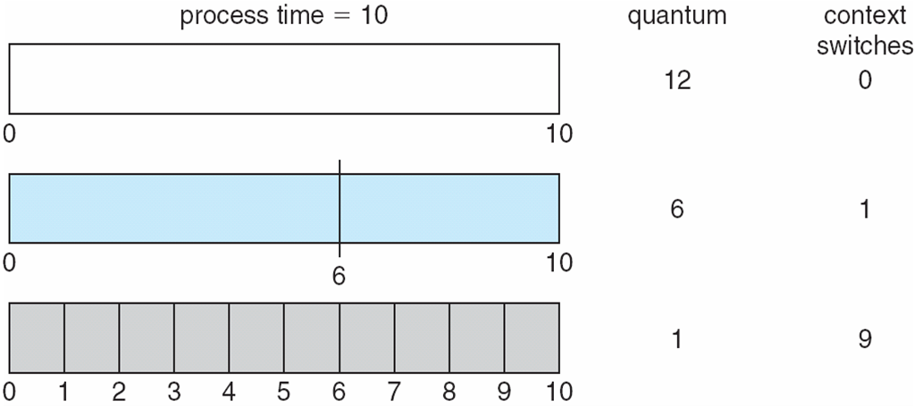
Time Quantum and Context Switch Time

Slide 24
Multilevel Queue
Ready queue is partitioned into separate queues, eg:
foreground (interactive)
background (batch)
Process permanently in a given queue
Each queue has its own scheduling algorithm:
foreground – RR
background – FCFS
Scheduling must be done between the queues:
Fixed priority scheduling; (i.e., serve all from foreground then from background). Possibility of starvation.
Time slice – each queue gets a certain amount of CPU time which it can schedule amongst its processes; i.e., 80% to foreground in RR and 20% to background in FCFS
Notes:
-Processes divided into foreground and background groups. Different priorities and scheduling needs.
-Foreground may have externally defined priority as well.

Slide 25
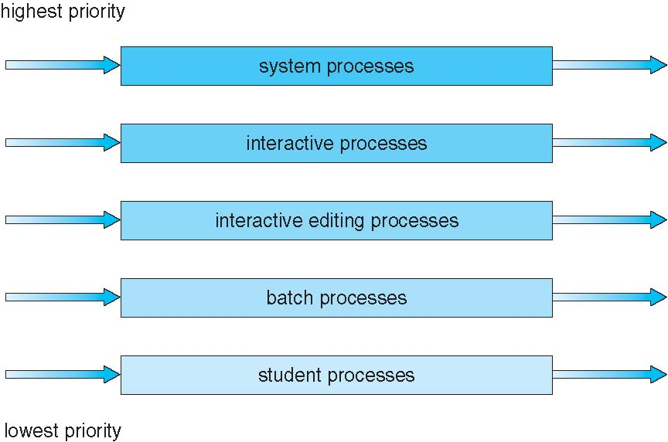
Multilevel Queue Scheduling

Slide 26
Multilevel Feedback Queue
A process can move between the various queues; ageing can be implemented this way
Multilevel-feedback-queue scheduler defined by the following parameters:
number of queues
scheduling algorithms for each queue
method used to determine when to upgrade a process
method used to determine when to demote a process
method used to determine which queue a process will enter when that process needs service
Notes:
-Provides more flexibility as compared with multilevel without feedback. But more complex.
-Can give highest priority to I/O-bound (short CPU burst) and interactive processes by moving CPU-bound processes to lower priority queues when they take too much of CPU time.

Slide 27
Multi-level Feedback Queues
Adaptive algorithm: Processes can move between queues based on past behavior.
Round robin scheduling in each queue -- time slice increases in lower priority levels.
Queue assignment:
Put new process in highest priority queue.
If CPU burst takes longer than one time quantum, drop one level.
If CPU burst completes before timer expires, move up one level.

Slide 28
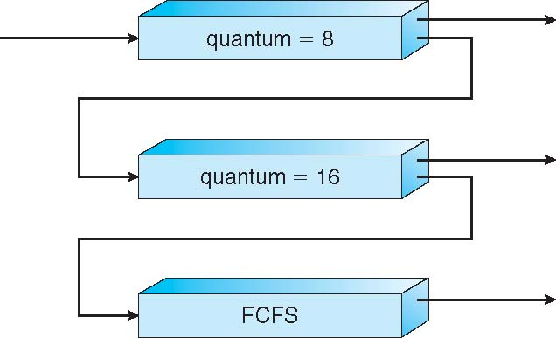
Example of Multilevel Feedback Queue
Three queues:
Q₀ – RR with time quantum 8 milliseconds
Q₁ – RR time quantum 16 milliseconds
Q₂ – FCFS
Scheduling
A new job enters queue Q₀
When it gains CPU, job receives 8 milliseconds
If it does not finish in 8 milliseconds, job is moved to queue Q₁
At Q₁ job is again served FCFS and receives 16 additional milliseconds
If it still does not complete, it is preempted and moved to queue Q₂
Notes:
-All processes in an upper queue served first.
-Process arriving in an upper queue prempts one in a lower queue.
-A new process is positioned at the end of the top-level FIFO queue Q₀.
-Q₀ is served fully before any job from Q₁ is served. Similarly for Q₂.
-Hence, priority given to process with CPU burst of 8ms or less.
-At the base level queue the processes circulate in round robin fashion until they complete and leave the system. Optionally, if a process blocks for I/O, it is 'promoted' one level, and placed at the end of the next-higher queue. This allows I/O bound processes to be favoured by the scheduler and allows processes to 'escape' the base level queue.
-Most adaptable to any system but it’s difficult to set all the parameters.

Slide 29
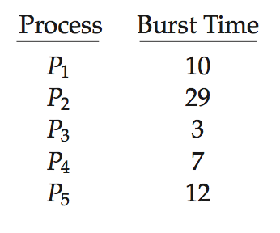
Algorithm Evaluation
How to select CPU-scheduling algorithm for an OS?
Determine criteria, then evaluate algorithms
Deterministic modeling
Type of analytic evaluation
Takes a particular predetermined workload and defines the performance of each algorithm for that workload
Consider 5 processes arriving at time 0:

Slide 30
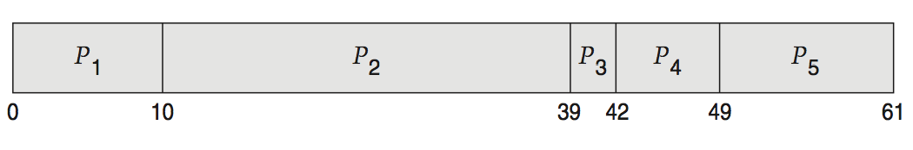
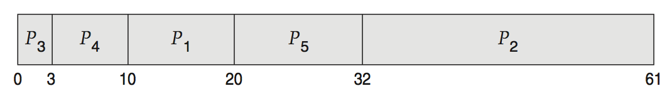
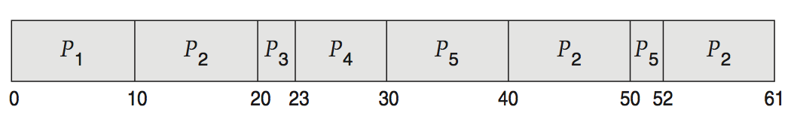
Deterministic Evaluation
For each algorithm, calculate minimum average waiting time
Simple and fast, but requires exact numbers for input, applies only to those inputs
FCFS is 28ms:
Non-preemptive SJF is 13ms:
RR is 23ms:
Notes:
- The main uses of deterministic modeling are in describing scheduling algorithms and providing examples. In cases where we are running the same program over and over again and can measure the program’s processing requirements exactly, we may be able to use deterministic modeling to select a scheduling algorithm.

Slide 31
Little’s Formula for queuing model
n = average queue length
W = average waiting time in queue
λ = average arrival rate into queue
Little’s law – in steady state, processes leaving queue must equal processes arriving, thus: n = λ x W
Valid for any scheduling algorithm and arrival distribution
For example, if on average 7 processes arrive per second, and normally 14 processes in queue, then average wait time per process = 2 seconds
Disadvantages of queuing models: Difficult mathematics; Models become unrealistic if are made mathematically tractable
Hence, queuing models are only approximations with questionable accuracy
Other Methods:
By using simulations and implementation can evaluate the algorithms.

Slide 32
End of Chapter 6
Modified by Alvi

